Slide 1




Aqil Helmi bin Wan Nordin (IS0106730)
FYP
Home
Project Background
Presentation
CRISP-DM Methodology
Summary
Predicting Job Satisfaction of Employees in a Private Organization

Slide 2

Project Background
Home
Introduction
Project Background
CRISP-DM Methodology
01
About Project
02
Justification
Summary
Build model to predict job satisfaction
Reference for pursuing career

Slide 3
Project Background
Home
Problem Statement
Project Background
CRISP-DM Methodology
01
Affecting Company
02
No Indicator
Summary
85% of employees actively disengaged at work
Not knowing whether the employee is satisfied

Slide 4
Project Background
Home
Objectives
Project Background
01
To develop a suitable model in predicting job satisfaction
02
CRISP-DM Methodology
To evaluate accuracy of the model
Summary
03
To identify attrributes that significantly affect job satisfaction

Slide 5
Methodology
Home
CRISP-DM
Project Background
01
Business Understanding
02
Data Understanding
CRISP-DM Methodology
Summary
03
Modelling
Data Preparation
04
05
Evaluation
06
Deployment

Slide 6
CRISP-DM Methodology
Home
Business Understanding
Project Background
- Understanding project background
- Defining analytic goals
- Identifying resources to perform the prediction
CRISP-DM Methodology
Summary

Slide 7
CRISP-DM Methodology
Home
Data Understanding
Project Background
- Dataset collected through a survey by Human Resources Department
-Exploring data (19478 rows, 30 columns)
- Understanding each attributes
- Perform Exploratory Data Analysis (EDA)
- Perform Cross Tabulation Analysis
CRISP-DM Methodology
Summary

Slide 8
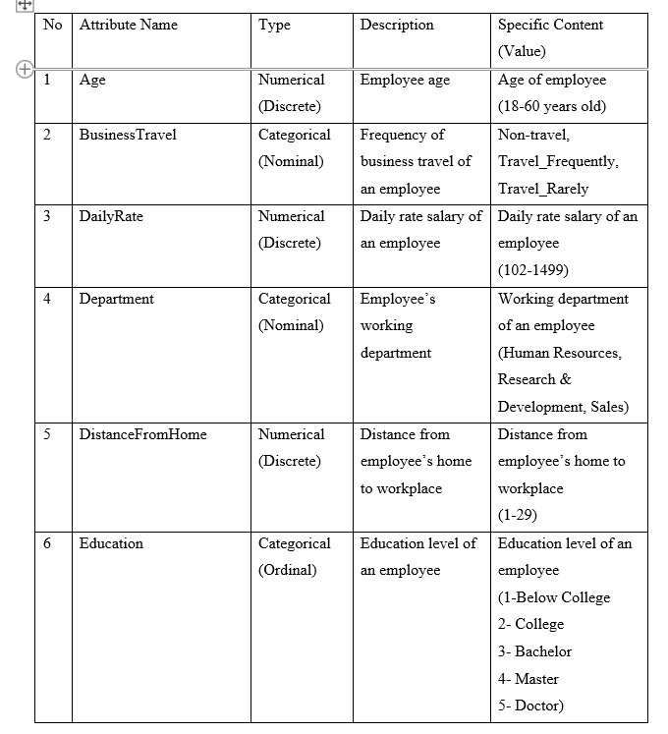
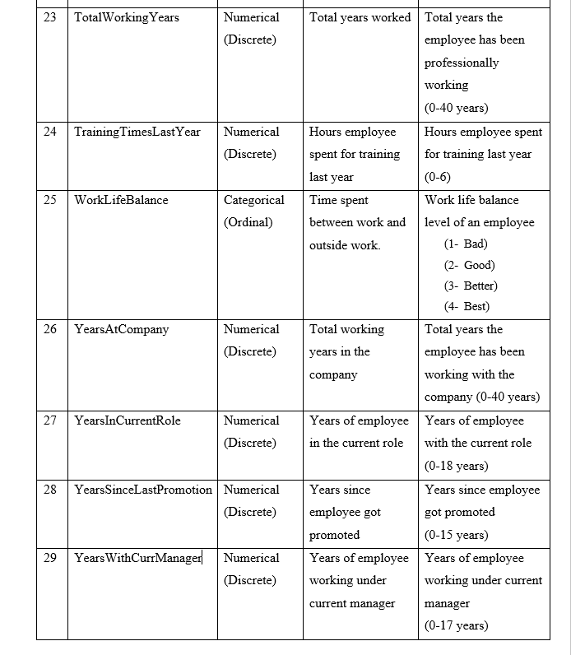
Understanding Attributes

Slide 9
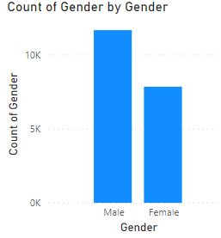
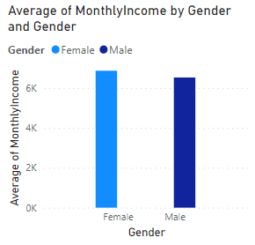
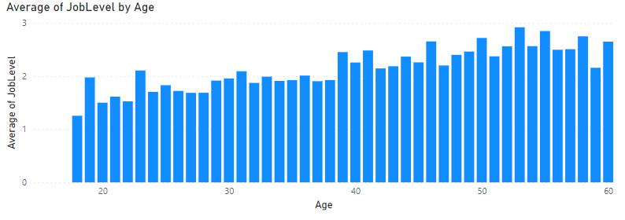
Exploratory Data Analysis

Slide 10
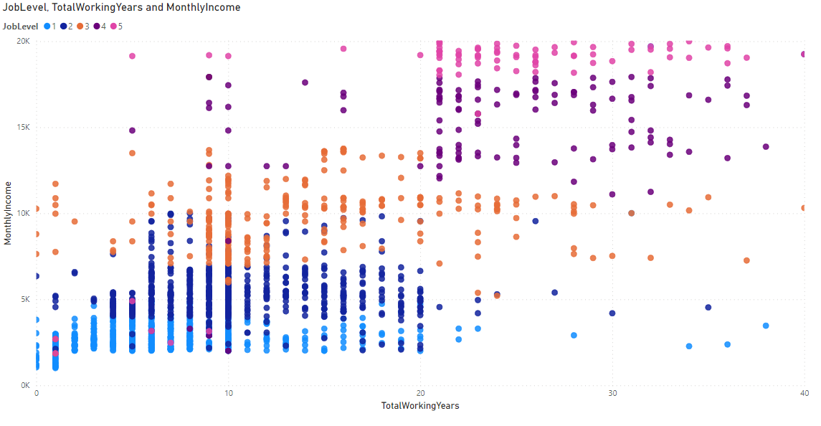
Cross Tabulation Analysis

Slide 11
CRISP-DM Methodology
Home
Data Preparation
Project Background
CRISP-DM Methodology
- Preparing raw data for analysis
- Data cleansing processes
Summary

Slide 12
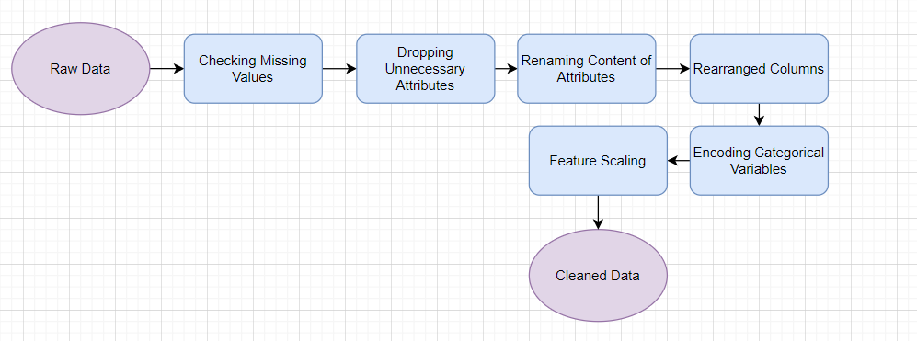
Data Cleansing Processes

Slide 13
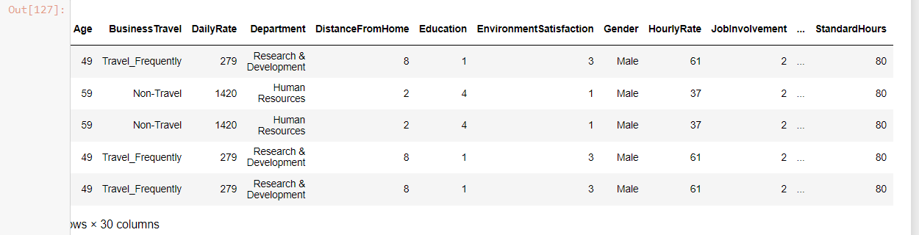
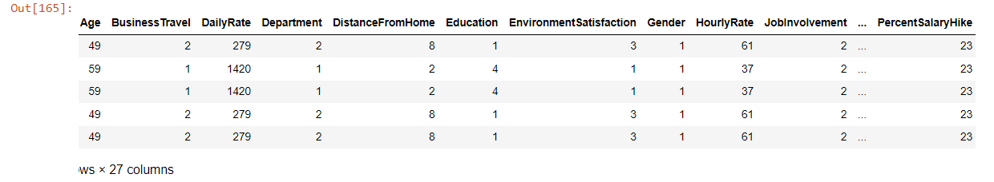
Raw Dataset VS Cleansed Dataset

Slide 14
CRISP-DM Methodology
Home
Modelling
Project Background
-Finding the right model
-Decision Tree Regression
- Solves both regression and classification problems
CRISP-DM Methodology
Summary

Slide 15
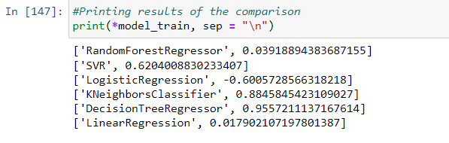
Finding The Right Model

Slide 16
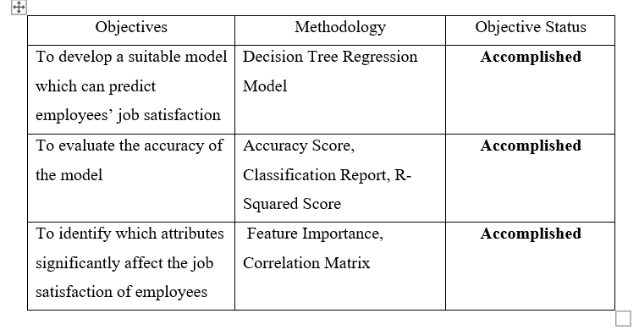
CRISP-DM Methodology
Evaluation
Home
Project Background
- To check whether the objectives have been met
CRISP-DM Methodology
Summary

Slide 17
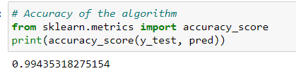
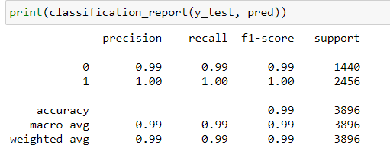
Evaluating Model
Accuracy
-- The percentages of correct predictions
Classification Report
Precision = Ability to accurately predict positive predictions
Recall = capability to identify all positive occurrences

Slide 18

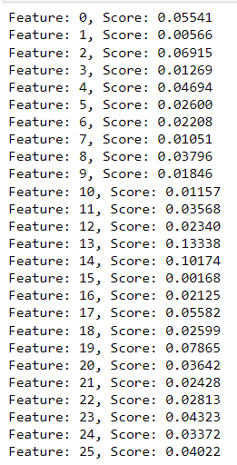
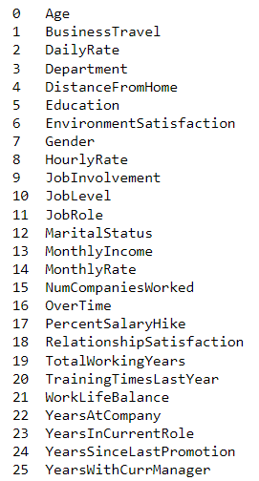
Evaluating Model
R-Squared Score
-- Movements of job satisfaction are totally explained by movements in the independent variables
Feature Importance
- The scores simply describe the "importance" of each feature in affecting job satisfaction

Slide 19
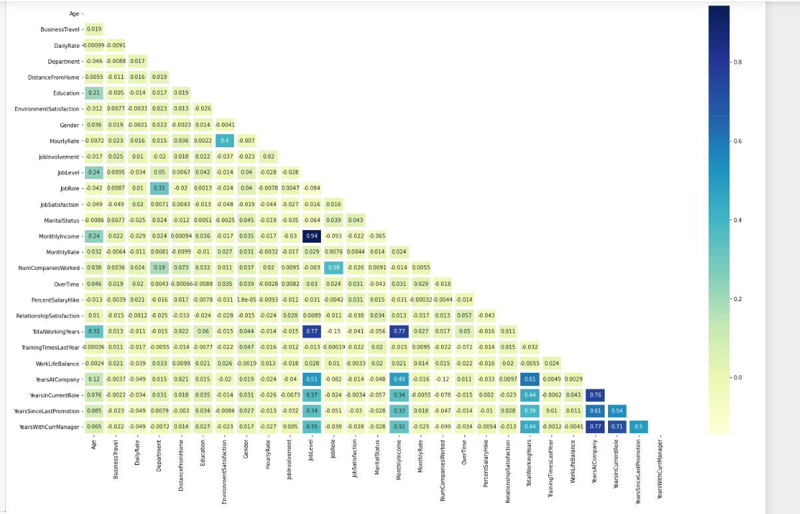



Correlation Matrix

Slide 20
CRISP-DM Methodology
Home
Deployment
Project Background
CRISP-DM Methodology
- Finding valuable insights for decision making
- Generate report
-- Help organization identify which employees are not satisfied
Summary

Slide 21
Summary
Home
Summary
Project Background
CRISP-DM Methodology
- Accuracy 99%
- Monthly Income is the most significant factor
- "Money Matters"
- Analytical goals achieved
Summary

Slide 22
Home
THANK
Project Background
CRISP-DM Methodology
YOU
Summary
By: Aqil Helmi

